Slide 1
Chapter 13

Slide 2
If slides with embedded WMF files do not have text properly aligned and fitting within the text boxes, this would indicate that you do not have Helvetica font installed on your computer, and Arial font has been substituted by default. Reinstalling Helvetica will most likely solve the problem.

Slide 3
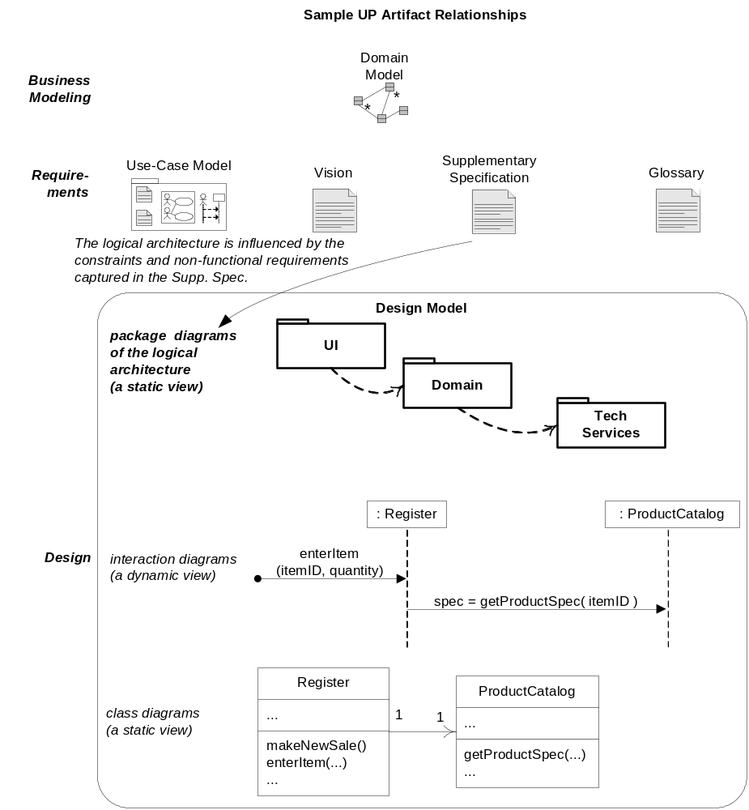
Fig. 13.1

Slide 4

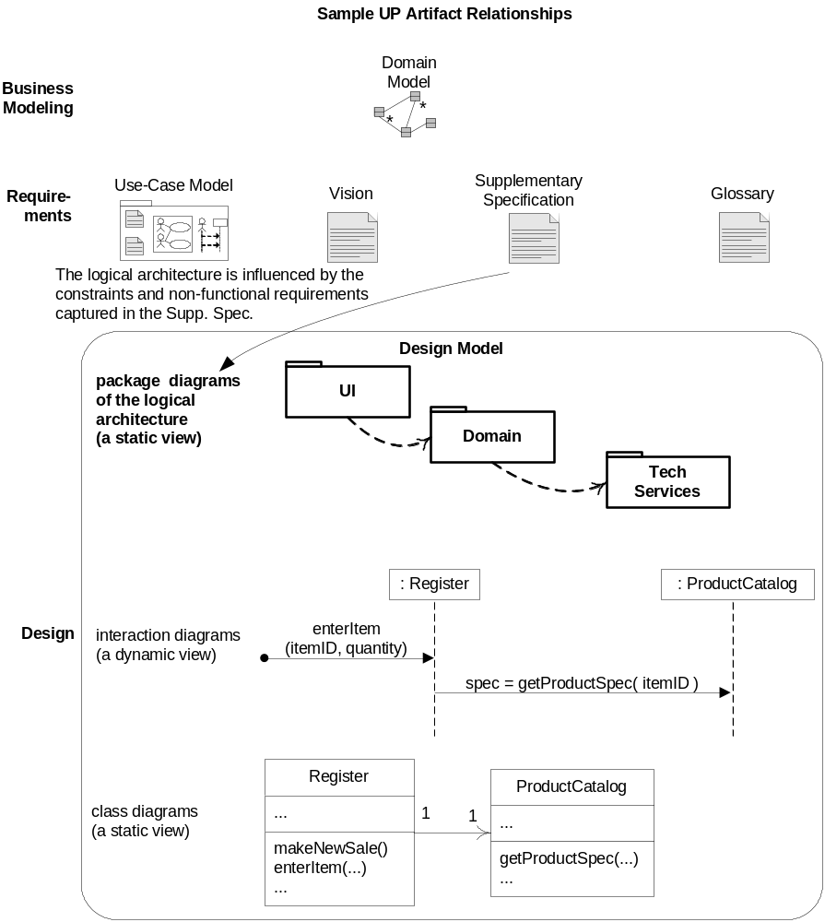
Fig. 13.1

Slide 5
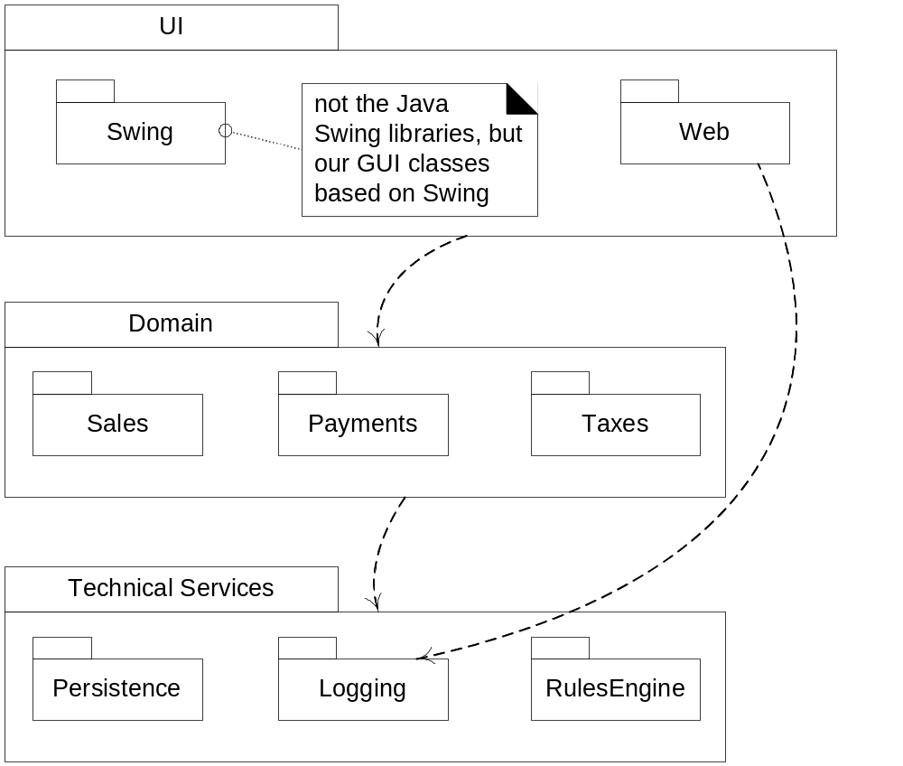
Fig. 13.2

Slide 6
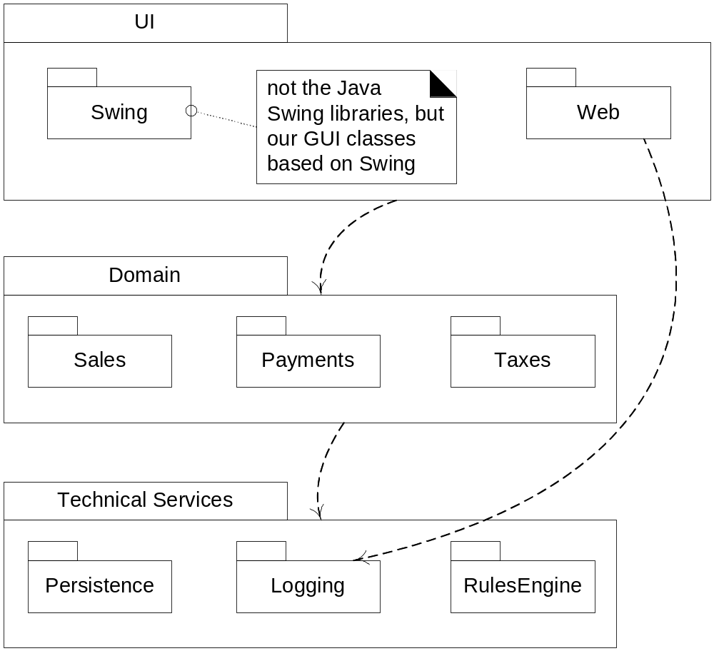
Fig. 13.2

Slide 7
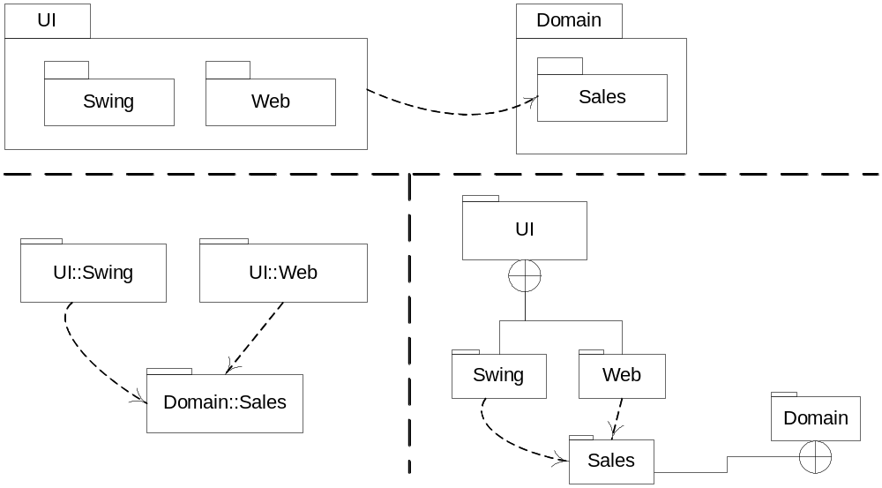
Fig. 13.3

Slide 8

Fig. 13.3

Slide 9
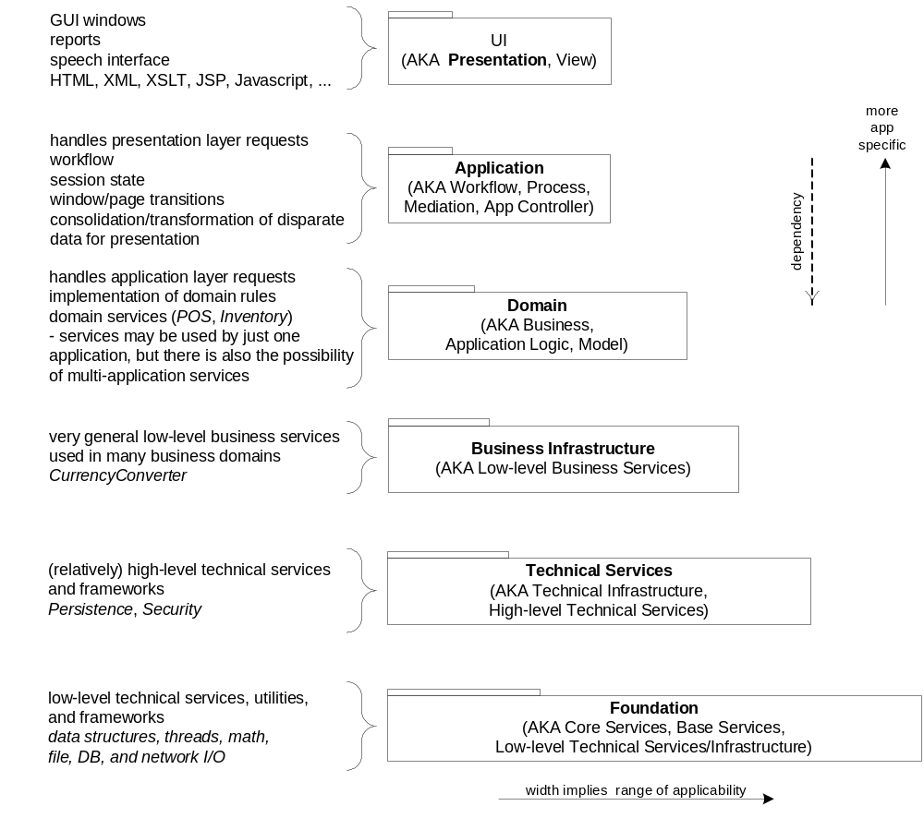
Fig. 13.4

Slide 10
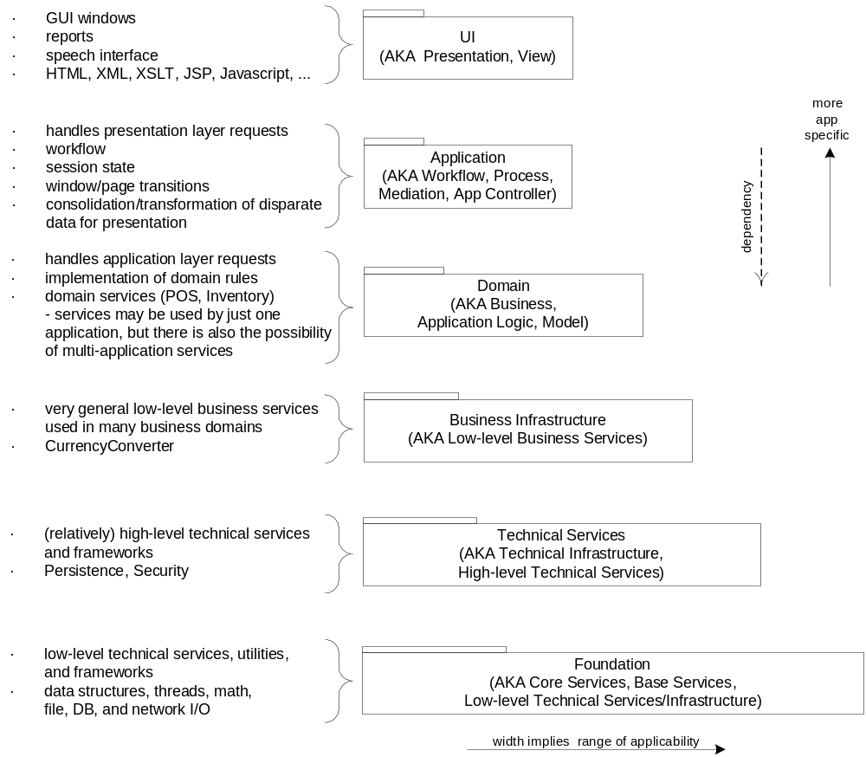
Fig. 13.4

Slide 11
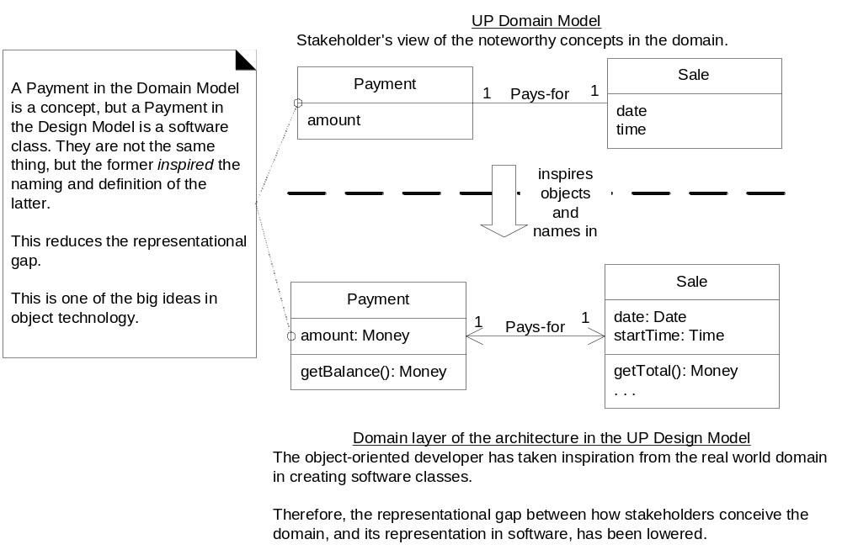
Fig. 13.5

Slide 12
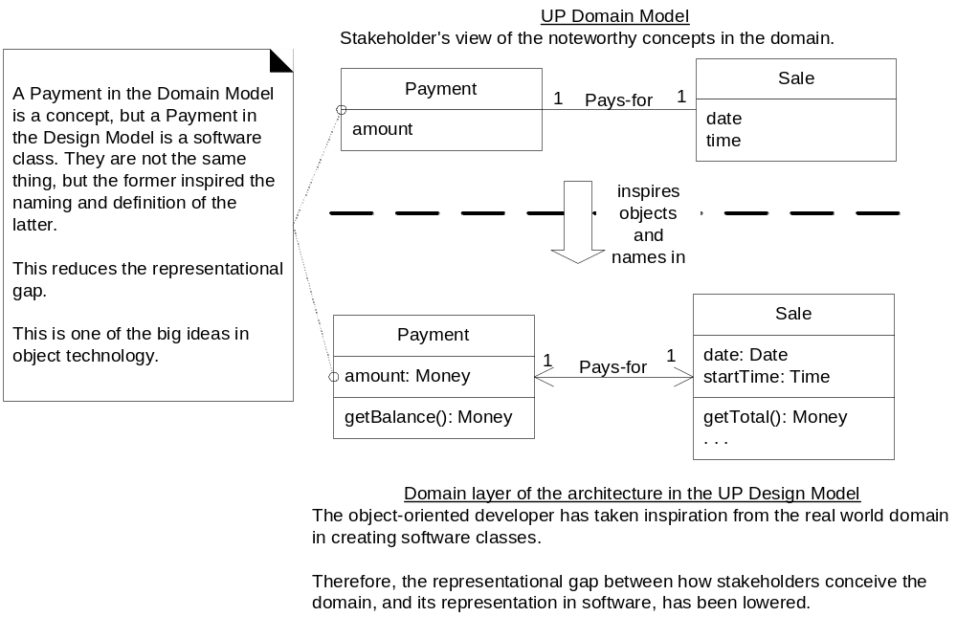
Fig. 13.5

Slide 13
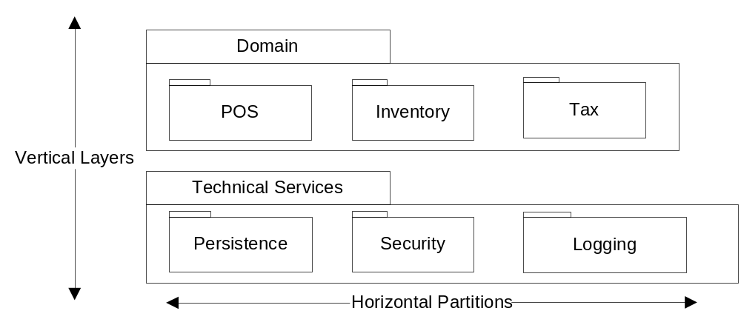
Fig. 13.6

Slide 14
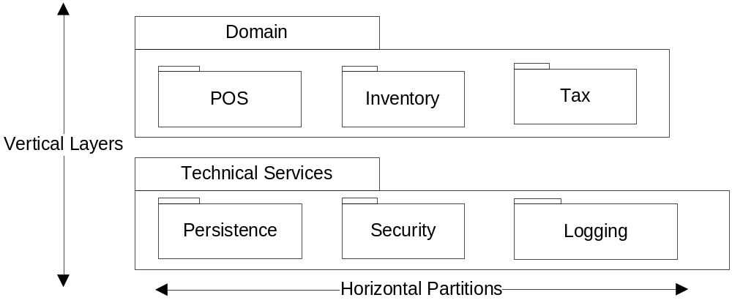
Fig. 13.6

Slide 15
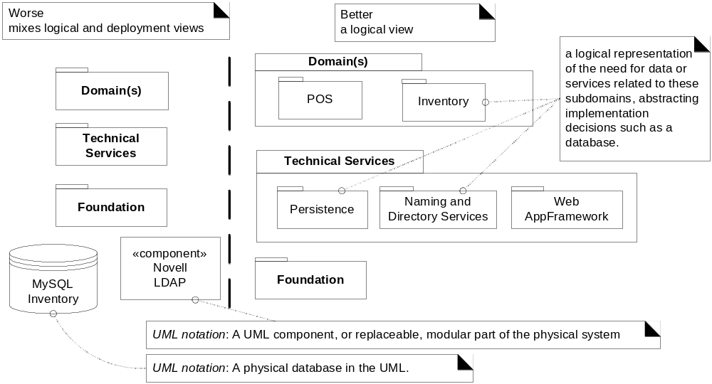
Fig. 13.7

Slide 16
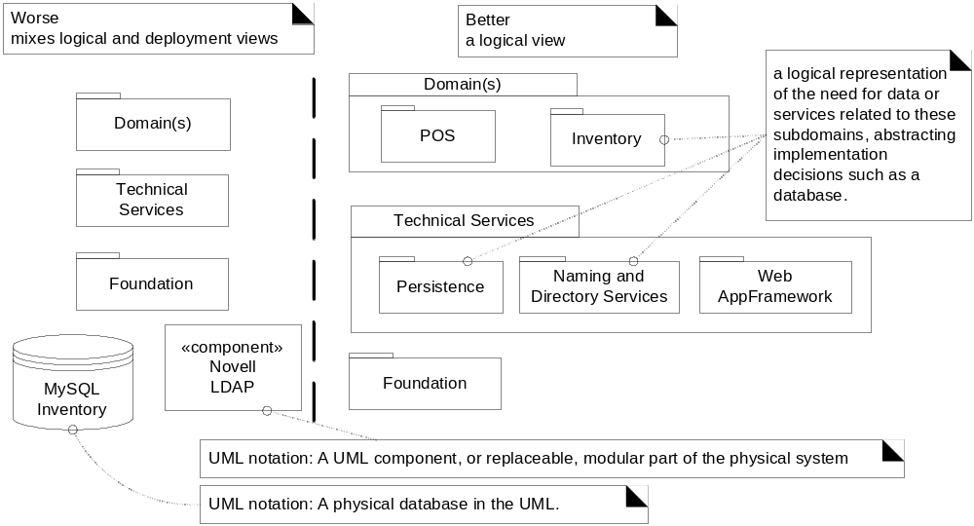
Fig. 13.7

Slide 17
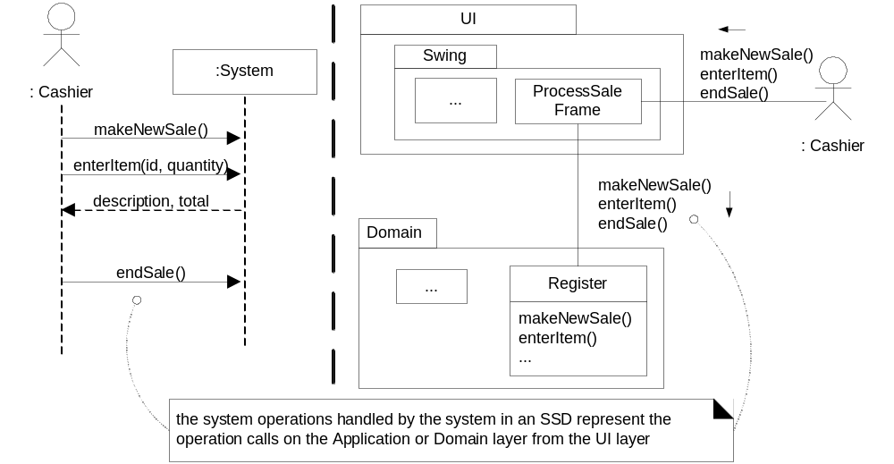
Fig. 13.8

Slide 18
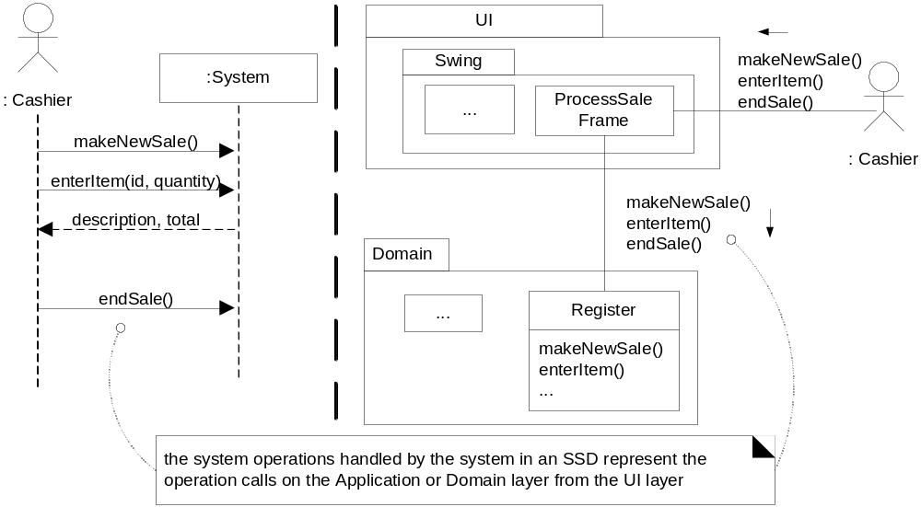
Fig. 13.8

